Slide 1
A whole government approach to health
Infographic and slides for use in PowerPoint presentations
16 December, 2024
Notes:
We want these slides and infographics to be a useful resource to help change the conversation about what builds good health. You are welcome to download, save and share them for education and non-commercial use. Please make sure that the Health Foundation and the source is clearly acknowledged in full.
If you have any further questions about using our resources in your work, please get in touch at website@health.org.uk

Slide 2

Health is our most precious asset. Good health and wellbeing enable people to reach their potential, drive economic growth, and foster stronger communities.
Our health is shaped by various factors in our environment, the building blocks of health.
Creating a society where everyone can thrive and lead a healthy life requires sustained efforts across all government departments, supported by a clear vision and leadership from the Prime Minister.
Notes:
Health is our most precious asset. Good health and wellbeing enable people to reach their potential, drive economic growth, and foster stronger communities.
Our health is shaped by various factors in our environment, the building blocks of health. From quality housing to secure employment, from social connections to access to green spaces and clean air, they all influence our health and well-being.
This is why we believe that people’s health is not just the Department of Health and Care’s job. Creating a society where everyone can thrive and lead a healthy life requires sustained efforts across all government sectors, supported by a clear vision and leadership from the Prime Minister.

Slide 3
Most – if not all – government departments have a role to play in building good health, even those that might not be first to mind.
Recognising and integrating health considerations across all departments is crucial for fostering good health and addressing health inequalities effectively.
Notes:
Most – if not all – government departments have a role to play in building good health, even those that might not be first to mind. For example, transportation policies can encourage active travel and reduce air pollution which in return can positively impact public health.
Recognising and integrating health considerations across all departments is crucial for fostering comprehensive public health strategies and addressing health inequalities effectively.

Slide 4
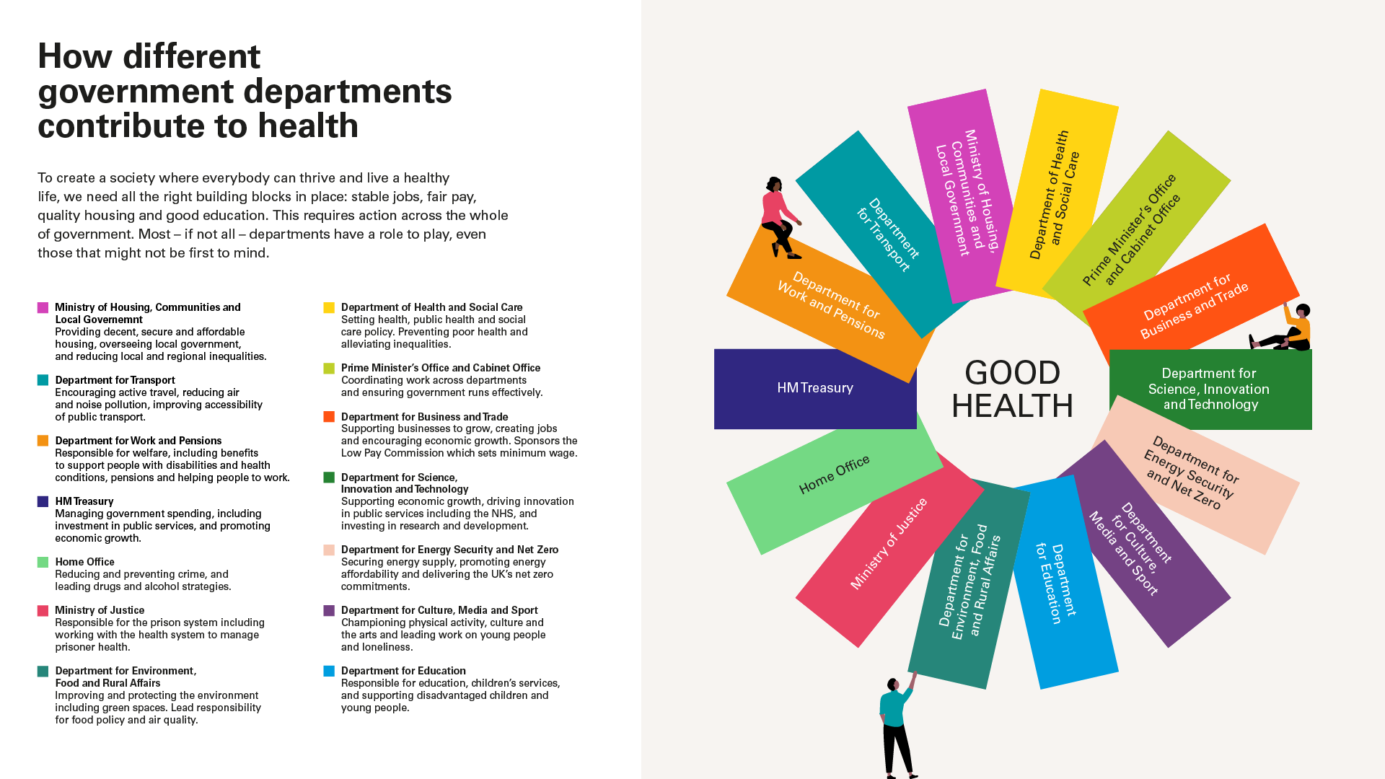

Slide 5


Slide 6
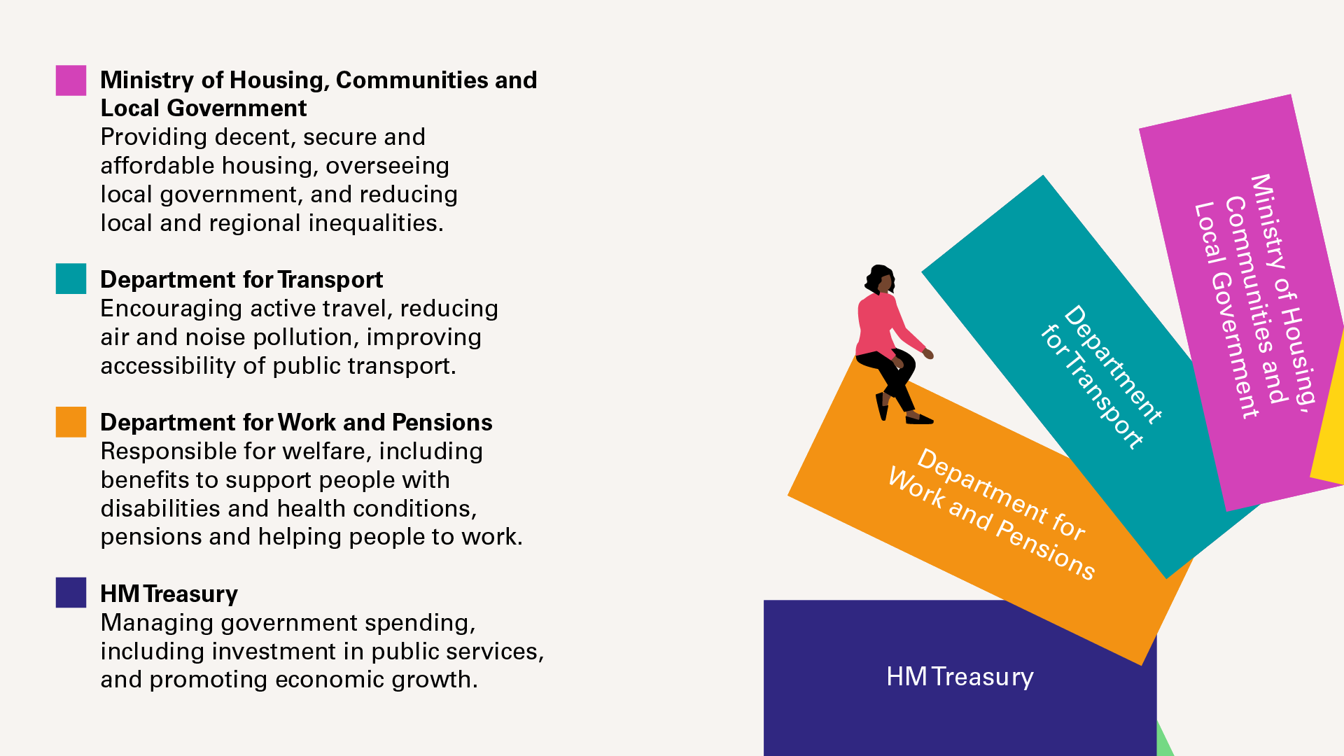

Slide 7
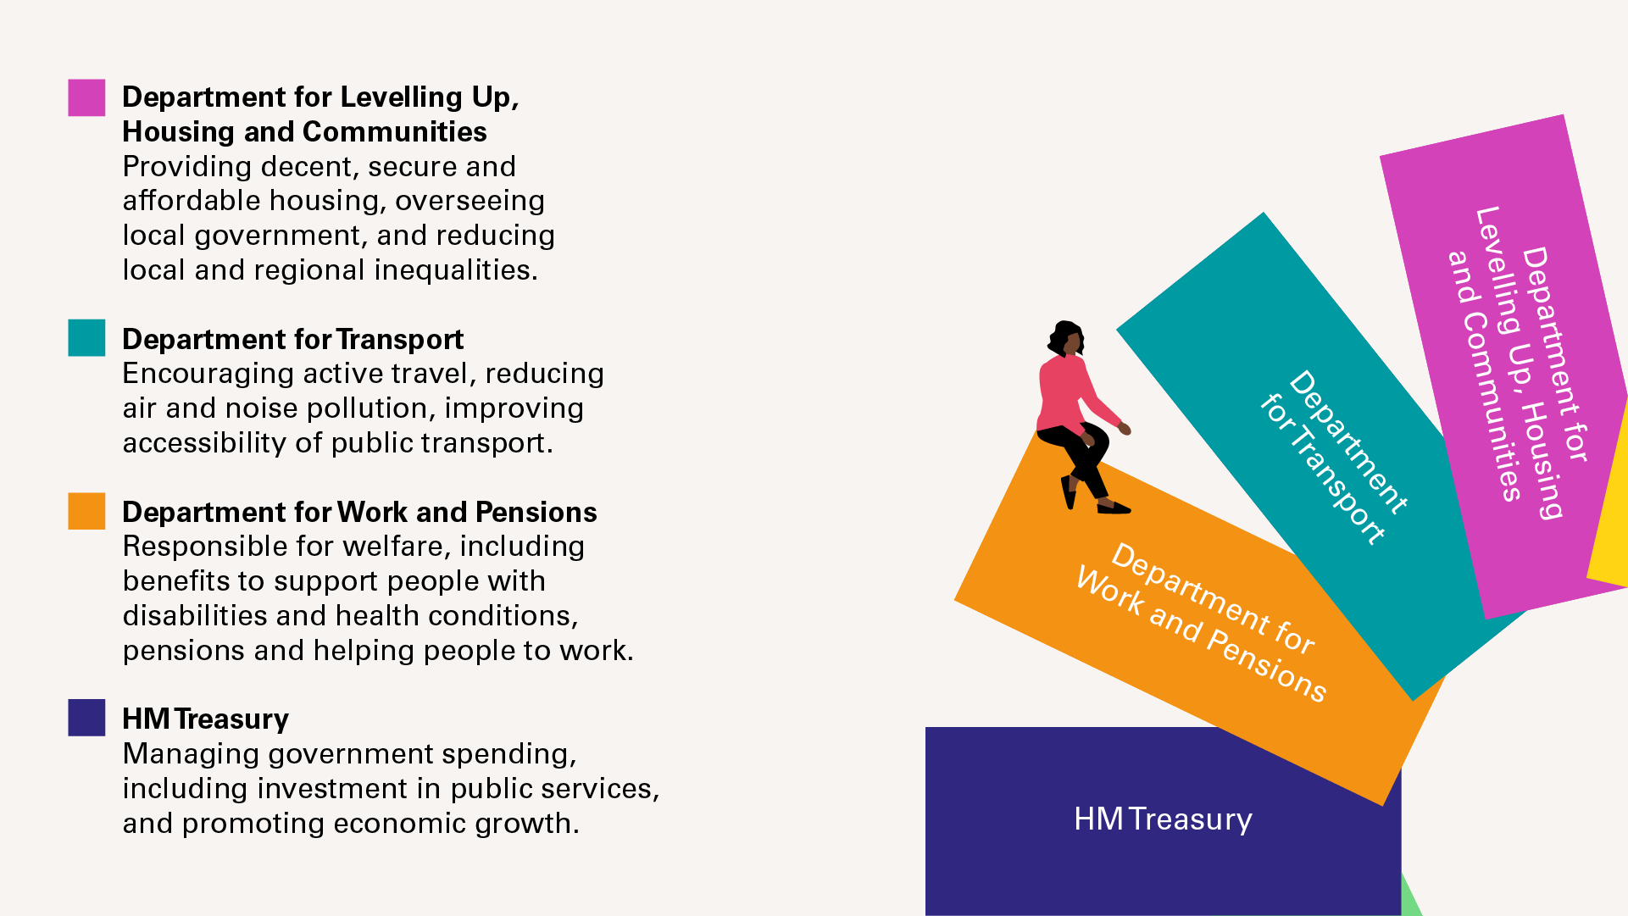
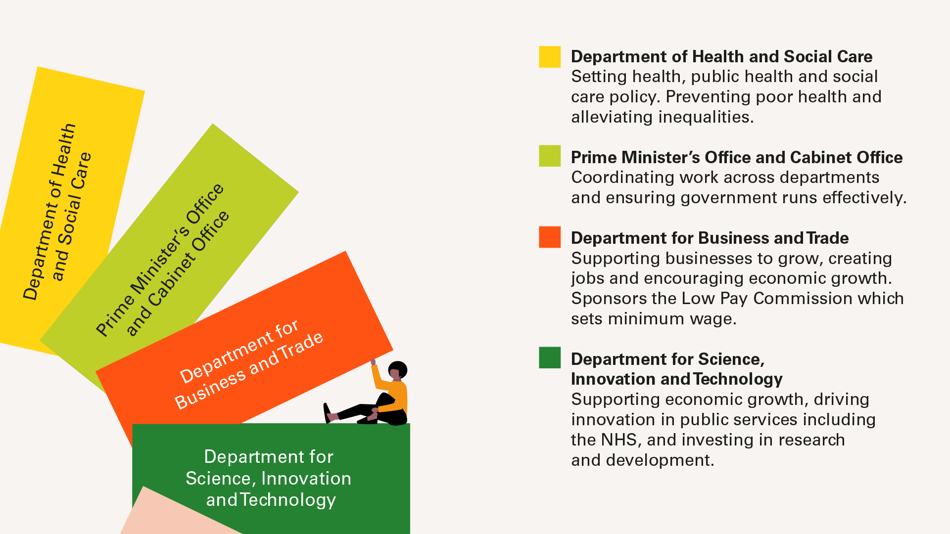

Slide 8
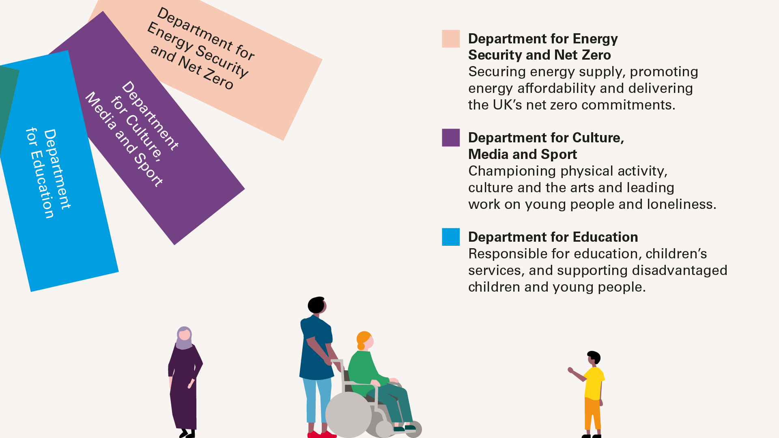

Slide 9
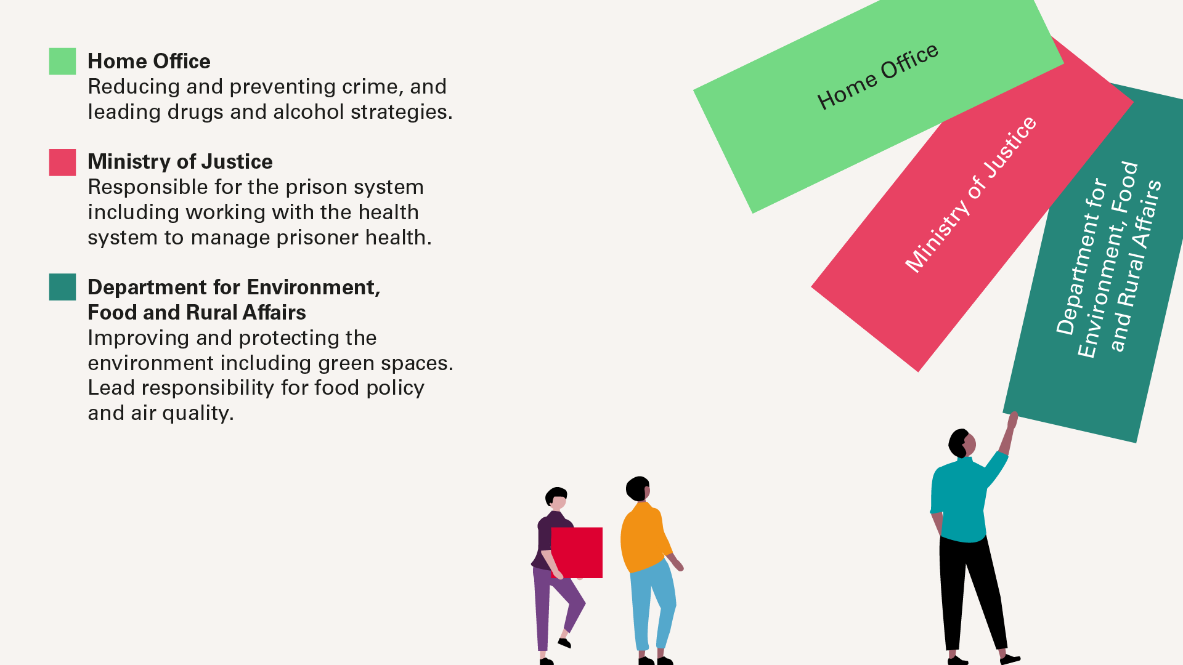

Slide 10
Challenges…
limited resources
competing priorities
inadequate investment
insufficient focus on prevention
lack of accountability
sustaining change over the long term
Notes:
Challenges…
We’re advocating for a whole government approach to be integrated in the renewed agenda for health. This would involve leading and coordinating efforts across various policy areas and sectors that impact health.
While this sounds straightforward in theory, it's challenging in practice, especially at a time of limited resources and competing priorities. It is critical that any cross-government approach has the mechanisms in place that can sustain change over the long term.
There's a growing consensus that improving health is a national imperative for individual well-being, economic prosperity, and the sustainability of public services. However, past efforts by successive governments have seen mixed success due to insufficient focus on prevention, inadequate investment, and lack of accountability.

Slide 11
..and some solutions
mechanisms in place to sustain change long term
lessons learned from the Climate Change Act 2008
an expert panel to develop recommendations
a new Bill of health health.org.uk/a-bill-of-health
Notes:
…and some solutions
In 2021, we published a paper addressing these challenges and suggesting various mechanisms to drive efforts across the whole of government. It is critical that any cross-government approach has the mechanisms in place that can sustain change over the long term, so that action doesn’t stall once the issue drops from the headlines. One focus of the current debate is what lessons can be learnt from the Climate Change Act 2008, which uses binding statutory targets (“net zero”) and an independent body (the Climate Change Committee) to review progress and policies, and to hold government to account.
Furthermore, to facilitate a long-term shift in government approaches to health improvement and reducing health inequalities, we’ve convened an Expert Panel to develop recommendations for a 'Bill of Health’. This proposal aims to establish mechanisms that enable sustained change. The final report is expected in autumn 2024. We’re also supporting the Get well soon Britain campaign, promoted by Health Equals, which also calls for the creation of a new Bill of Health.

Slide 12
www.health.org.uk

